Slide 1
ConnectMT Application webinar
Agenda
Website Orientation
Map Orientation
Registering with website
Online Application
Application Guide
Timeline
Online Challenge Process
Questions and Answers
https://connectmt.mt.gov

Slide 2
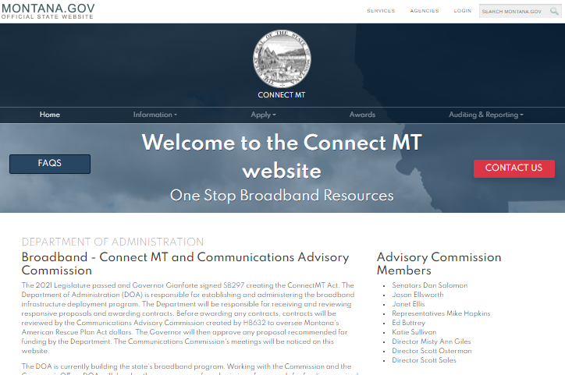
Website Orientation
https://connectmt.mt.gov/
Website includes:
FAQs
Contact information
Information about the statewide broadband map, federal resources, announcements, events, webinars, forms, and guides
Application link and guidance
Project challenge process
Awards
Auditing and reporting

Slide 3
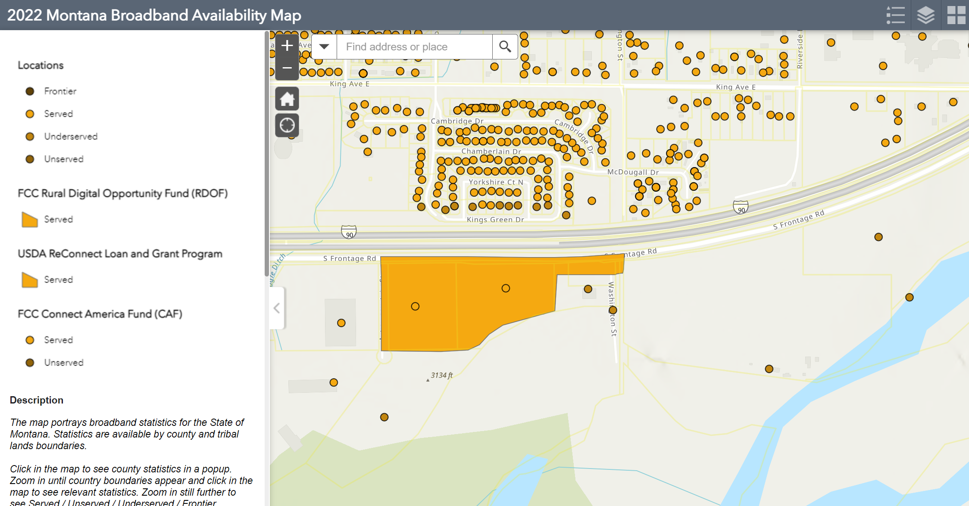
Map Orientation
The State of Montana has selected LightBox to create broadband serviceable location analytics and mapping capabilities for the state.
LightBox offered Montana an opportunity to get a precise accounting and assessment of the current landscape when it comes to broadband
Georgia and Alabama have already leveraged LightBox data to create highly accurate broadband serviceable location mapping, amid the Federal Government’s push for greater digital equality

Slide 4
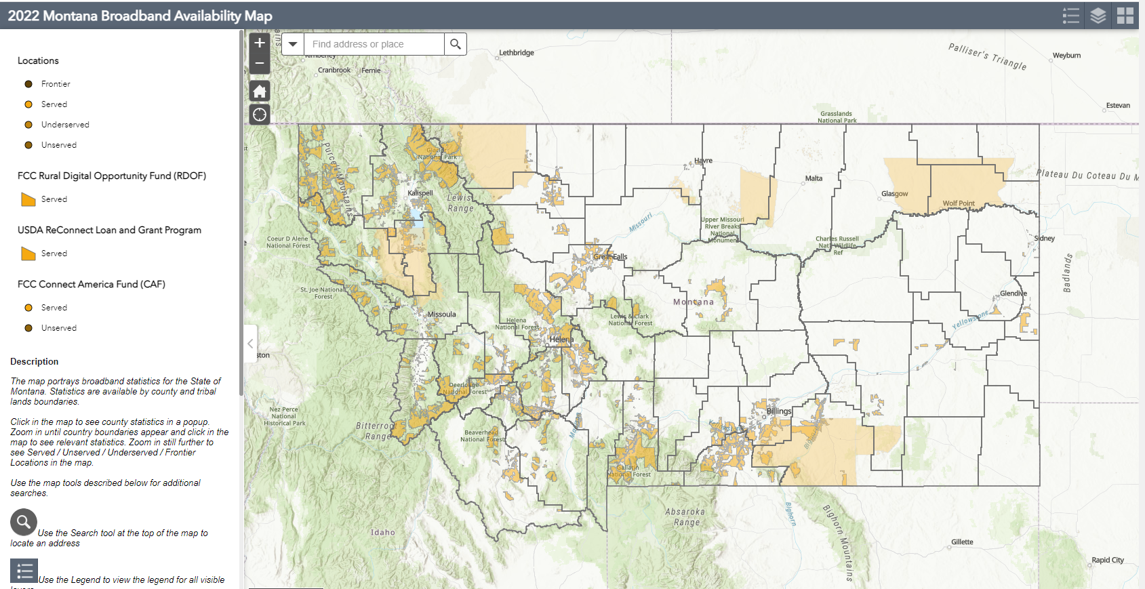
2022 Montana Broadband Availability Map

Slide 5
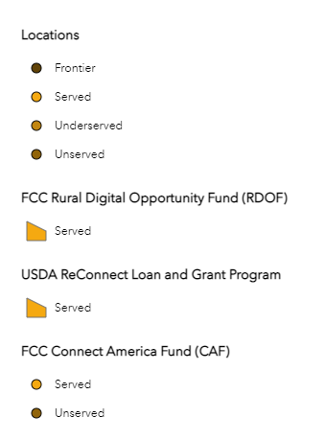
2022 Montana Broadband Availability Map

Slide 6
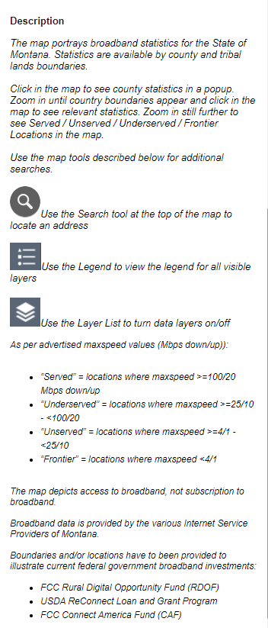
2022 Montana Broadband Availability Map

Slide 7
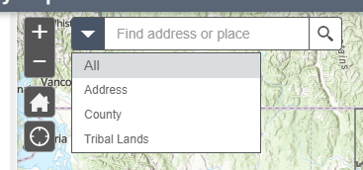
2022 Montana Broadband Availability Map

Slide 8
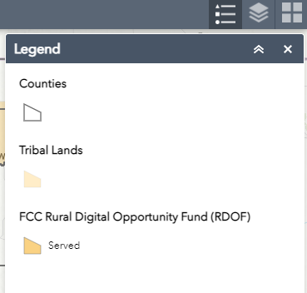
2022 Montana Broadband Availability Map

Slide 9
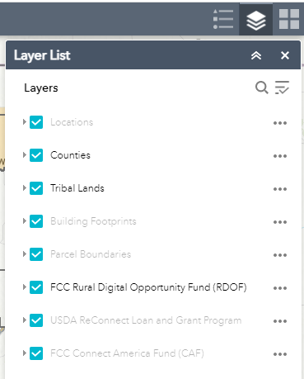
2022 Montana Broadband Availability Map

Slide 10
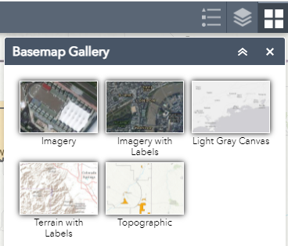
2022 Montana Broadband Availability Map

Slide 11
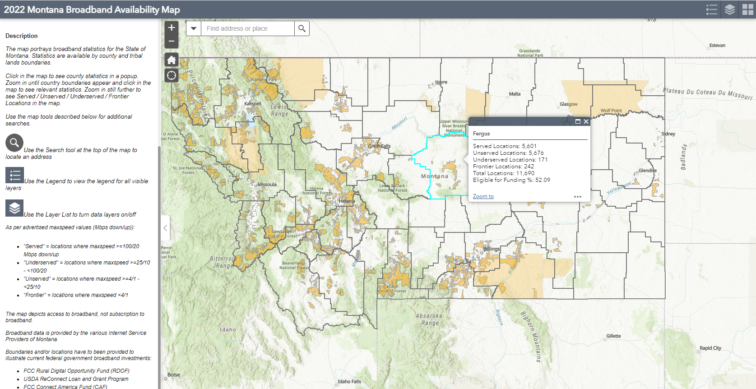
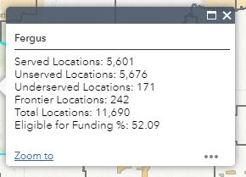
2022 Montana Broadband Availability Map

Slide 12
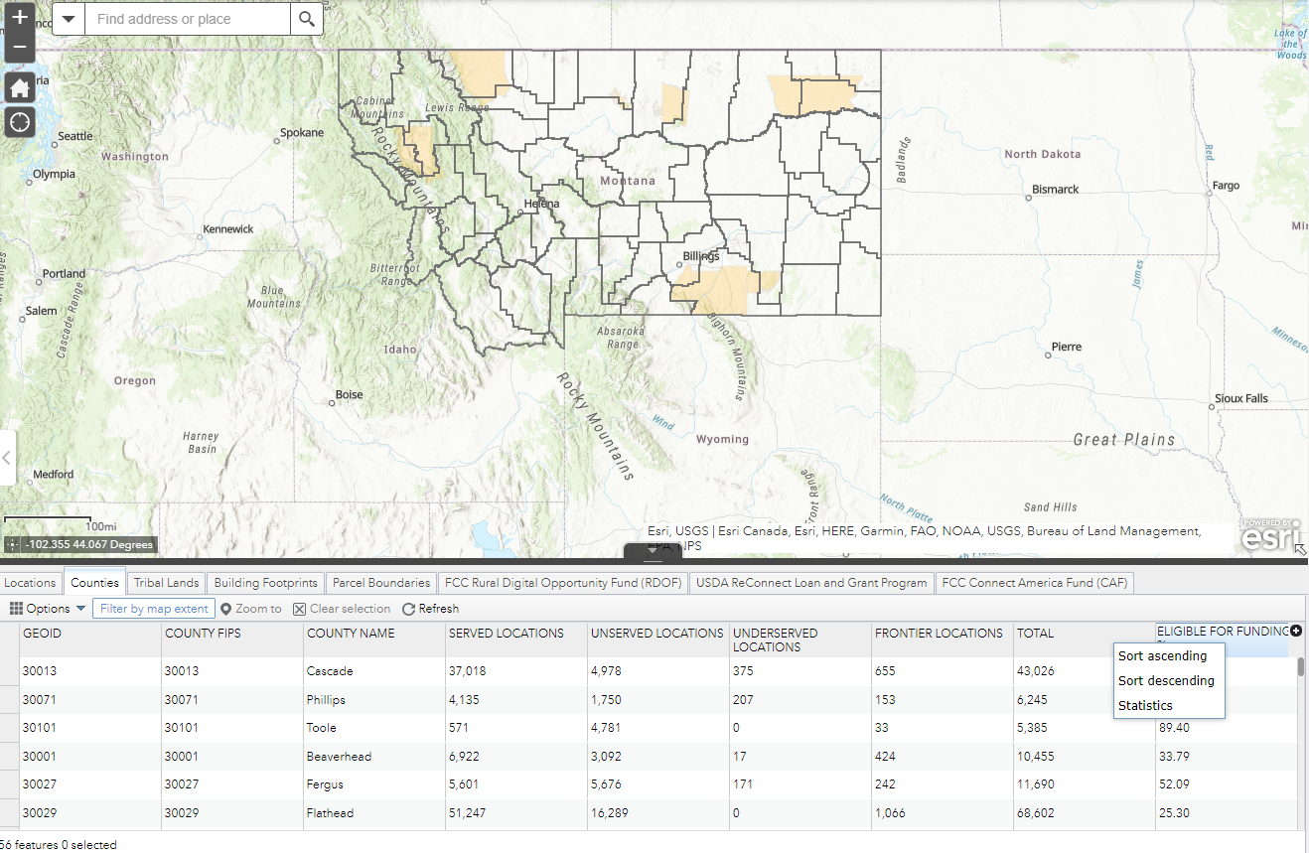
2022 Montana Broadband Availability Map

Slide 13
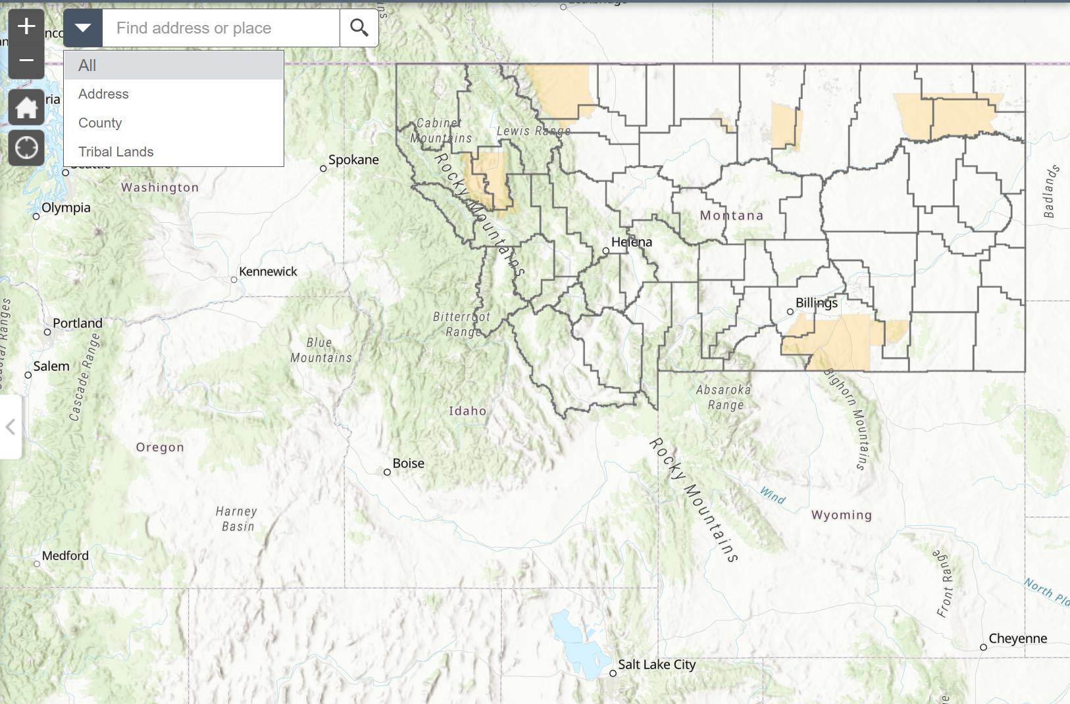
2022 Montana Broadband Availability Map

Slide 14
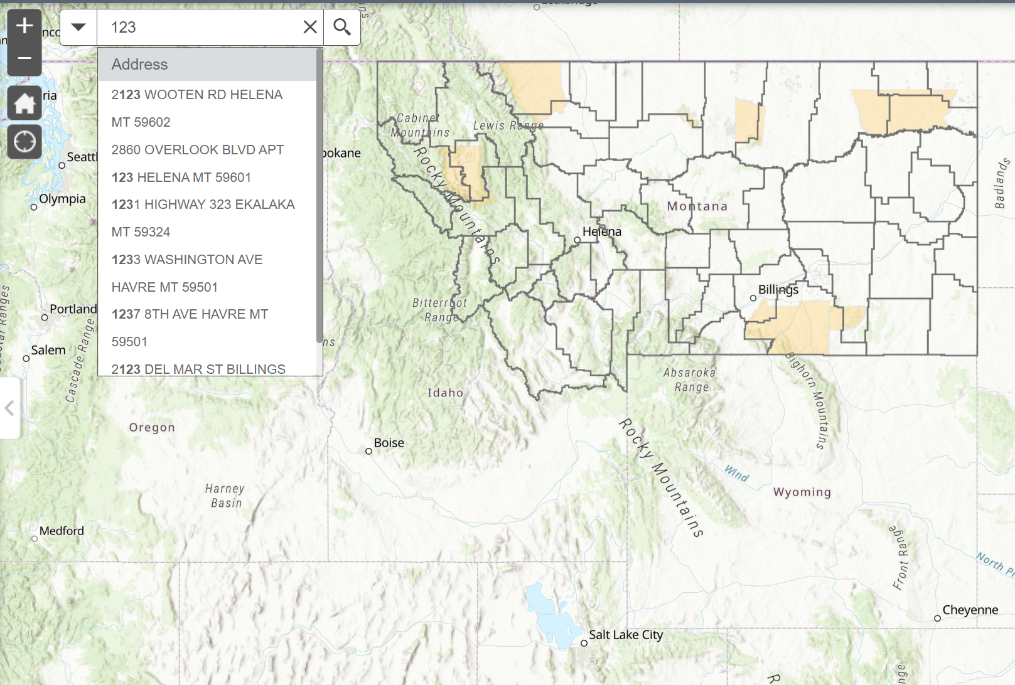
2022 Montana Broadband Availability Map

Slide 15
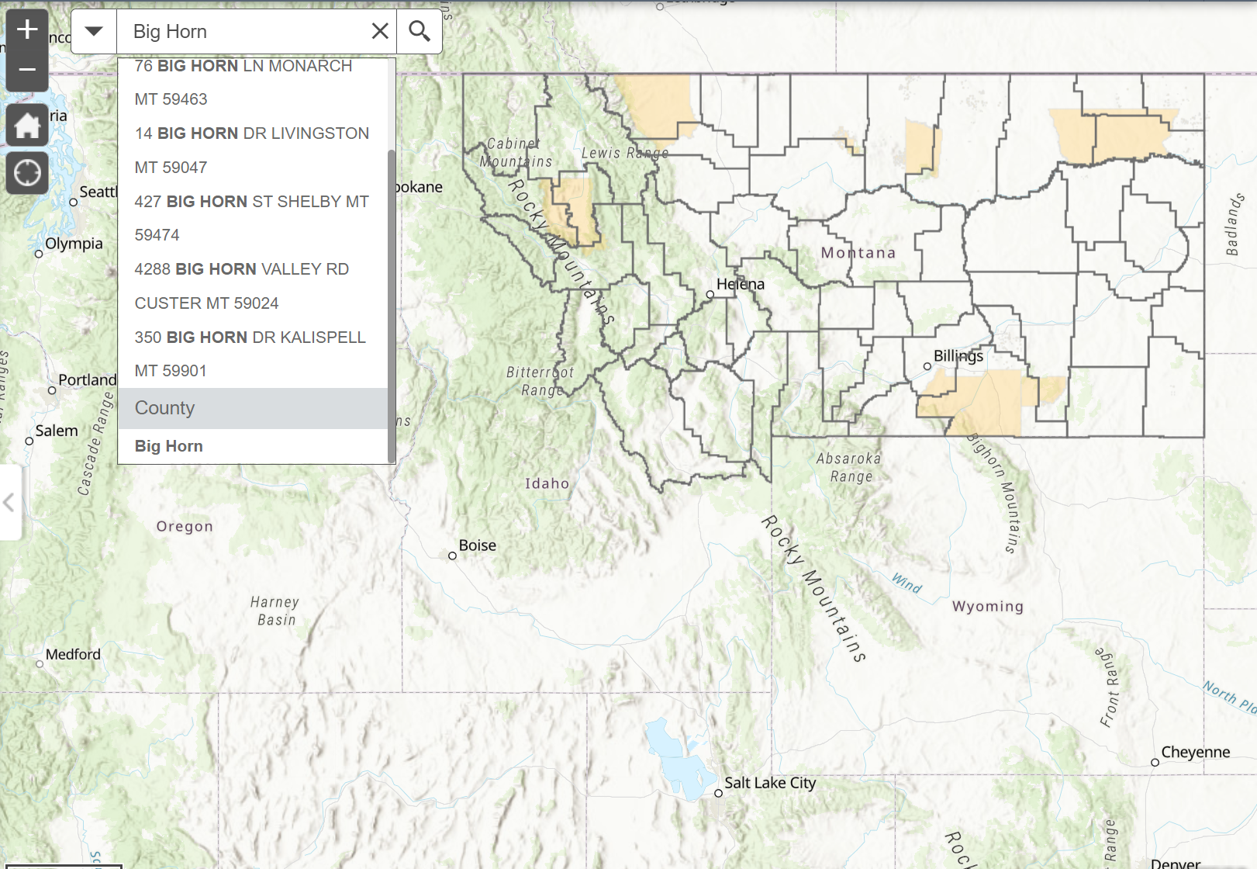
2022 Montana Broadband Availability Map

Slide 16
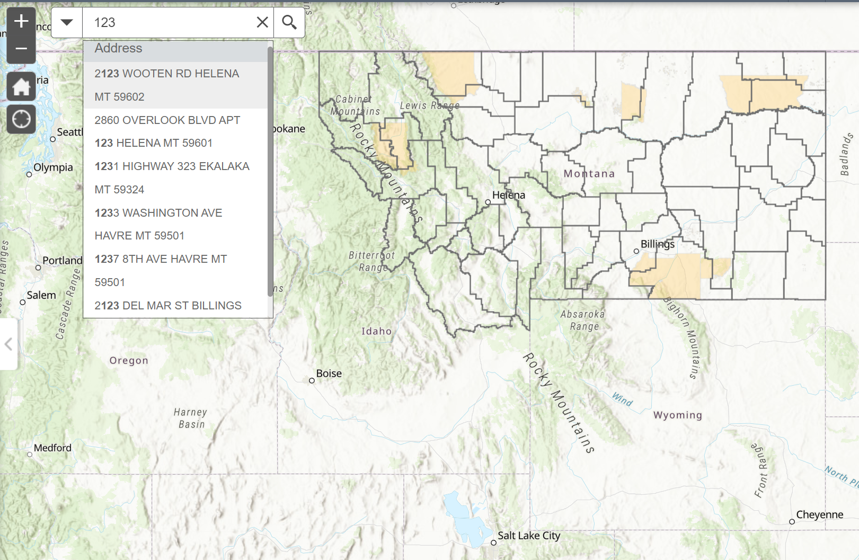
2022 Montana Broadband Availability Map

Slide 17
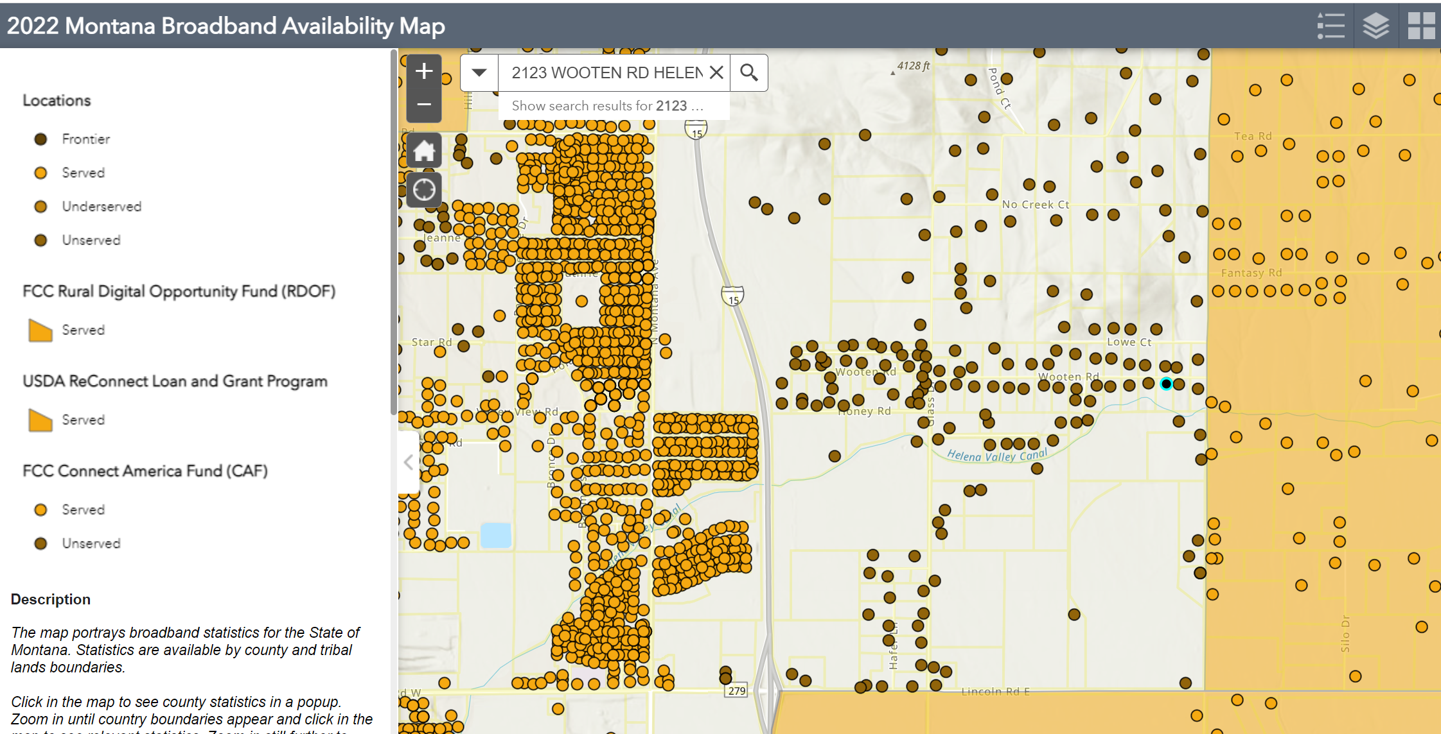
2022 Montana Broadband Availability Map

Slide 18
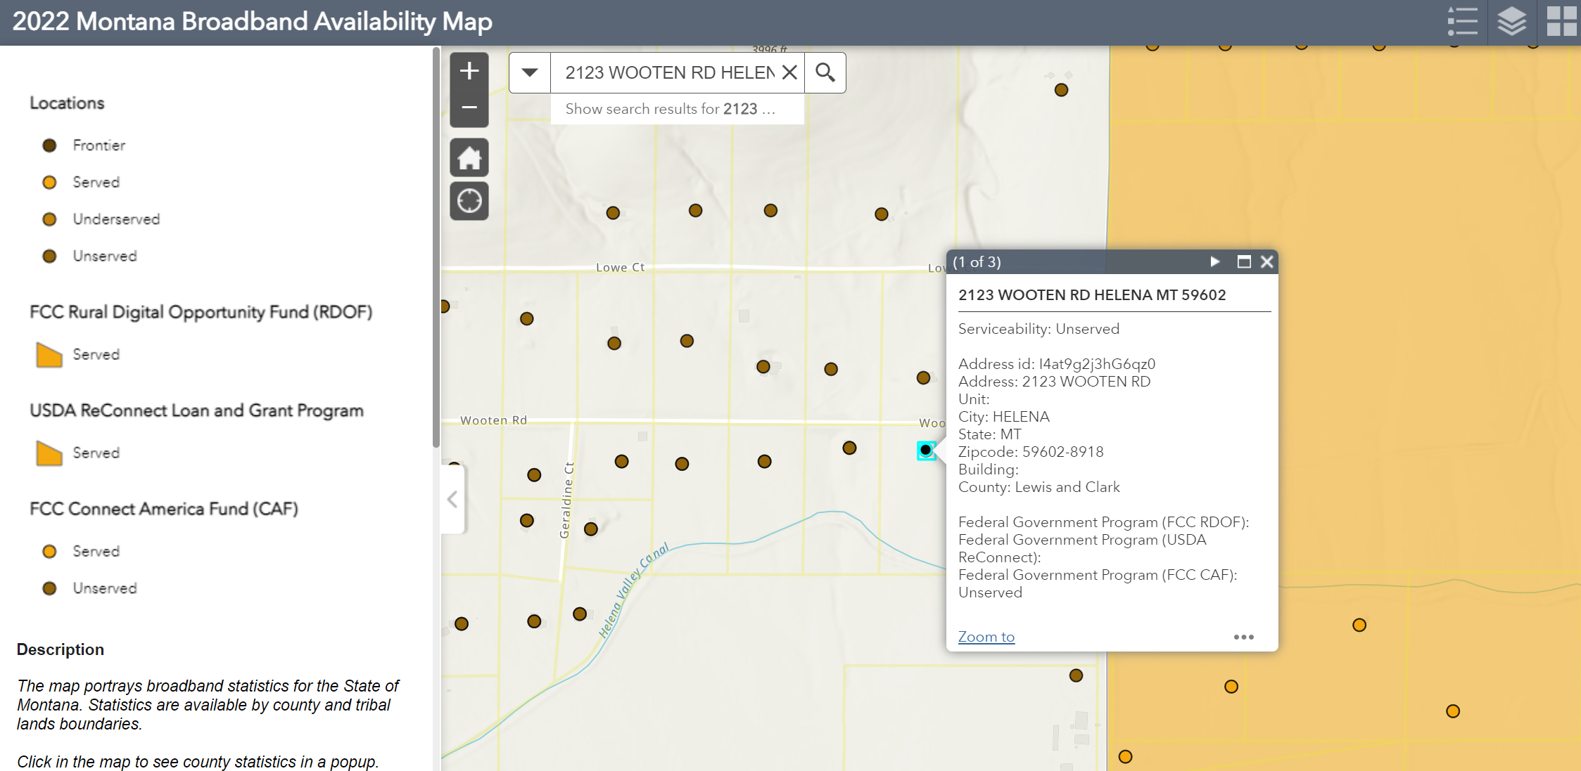
2022 Montana Broadband Availability Map

Slide 19
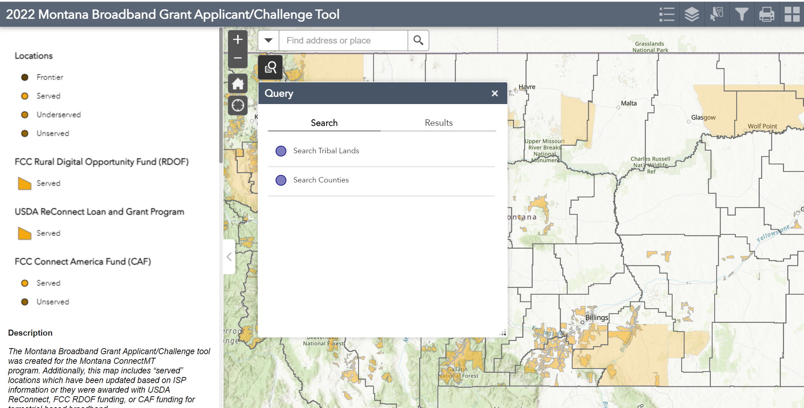
2022 Montana Broadband
Grant Applicant / Challenge Map

Slide 20
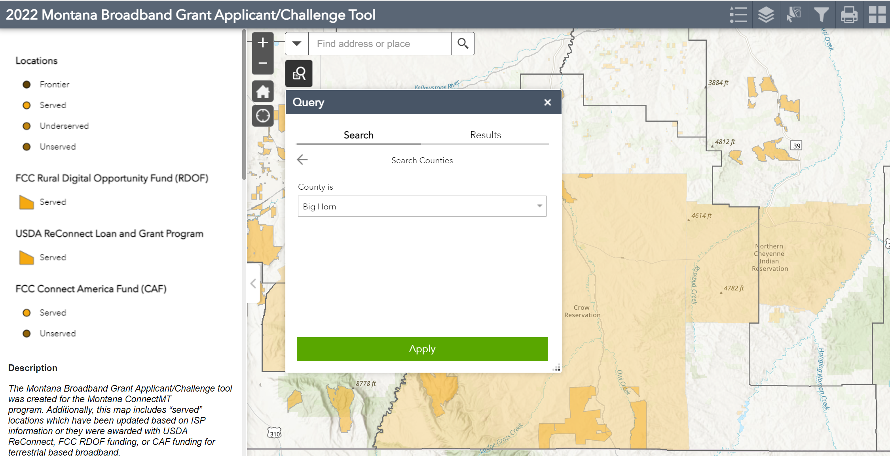
2022 Montana Broadband
Grant Applicant / Challenge Map

Slide 21
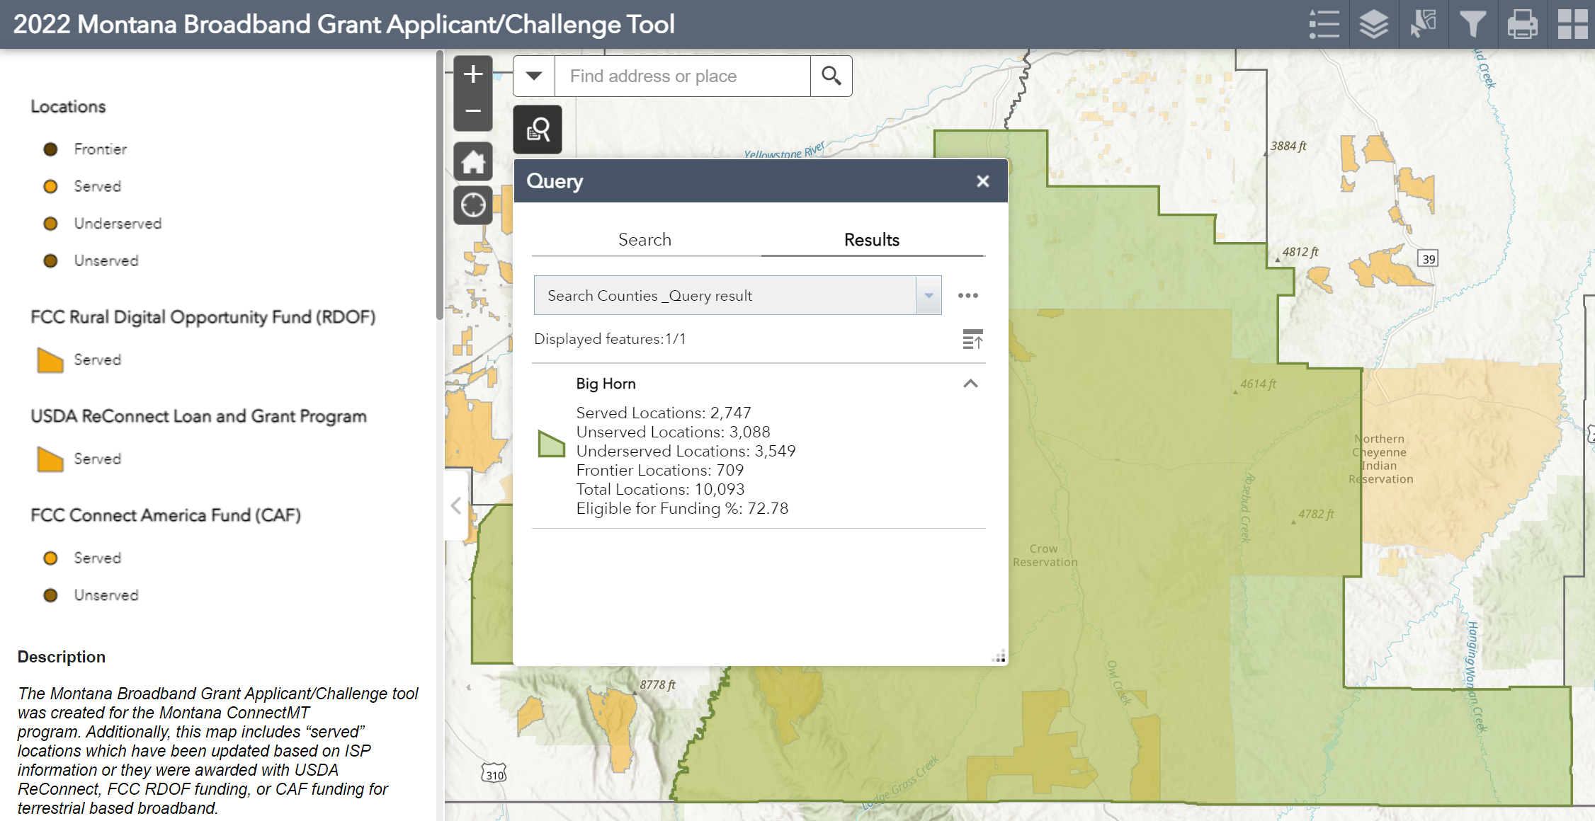
2022 Montana Broadband
Grant Applicant / Challenge Map

Slide 22
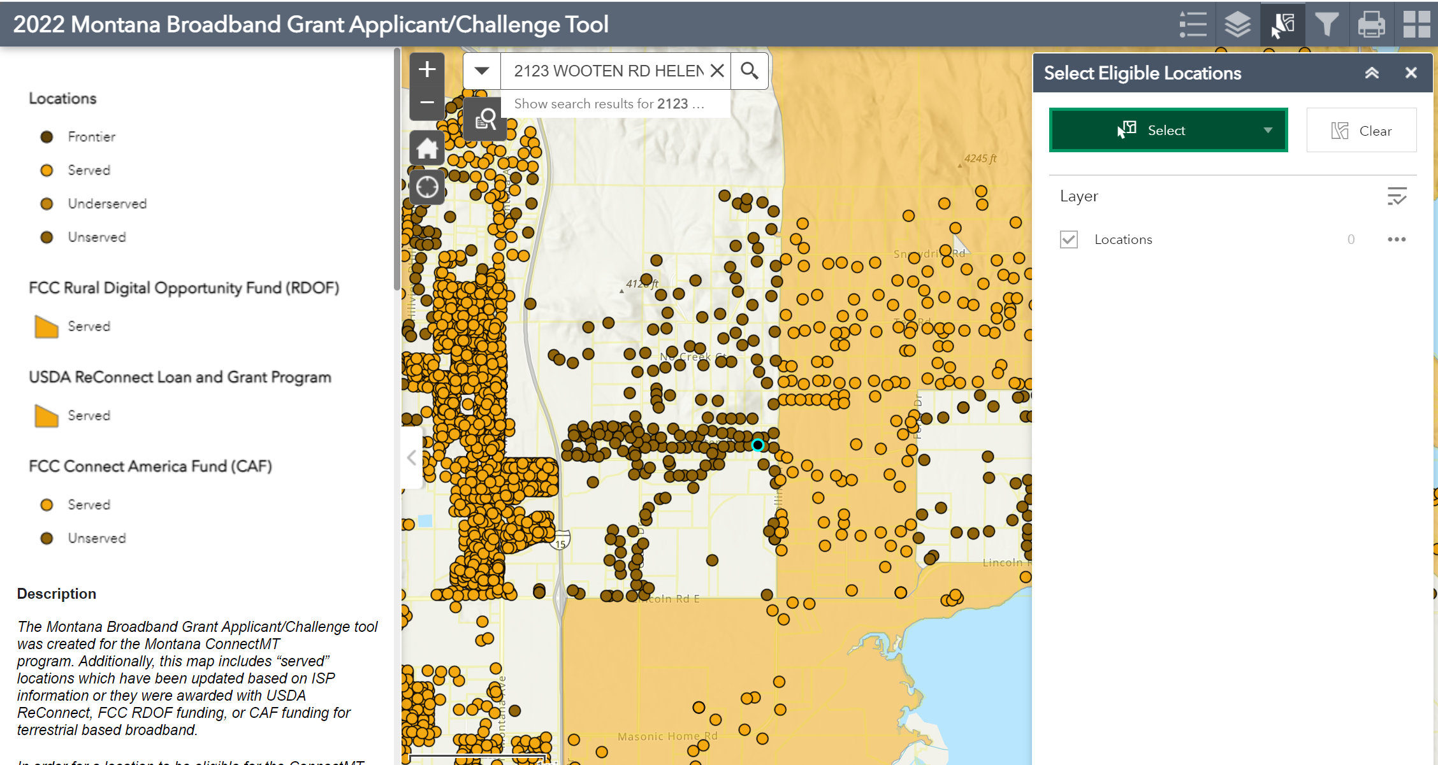
2022 Montana Broadband
Grant Applicant / Challenge Map

Slide 23
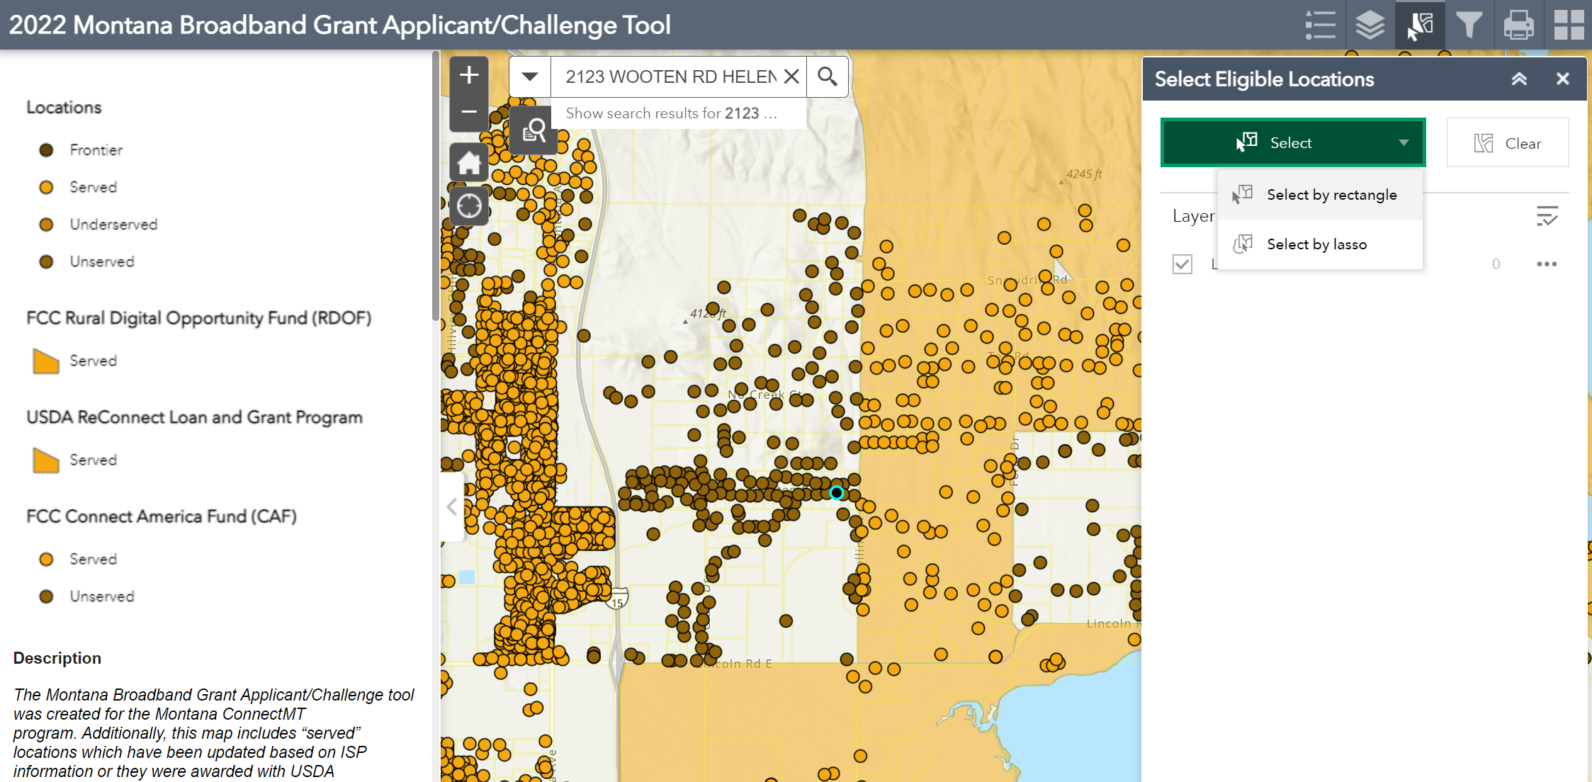
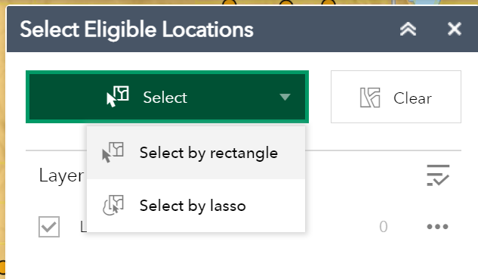
2022 Montana Broadband
Grant Applicant / Challenge Map

Slide 24
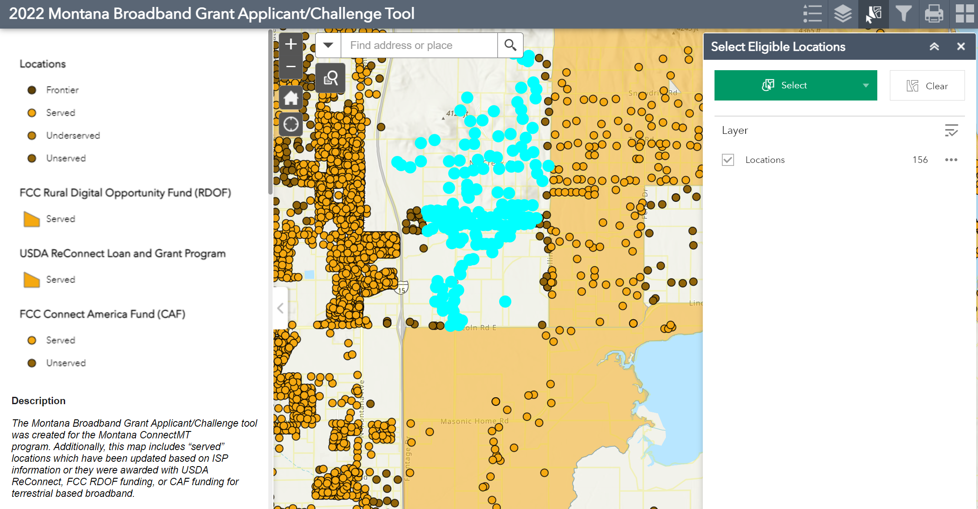
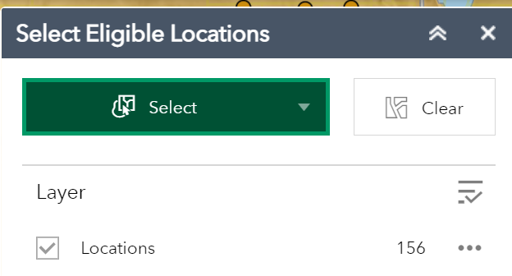
2022 Montana Broadband
Grant Applicant / Challenge Map

Slide 25
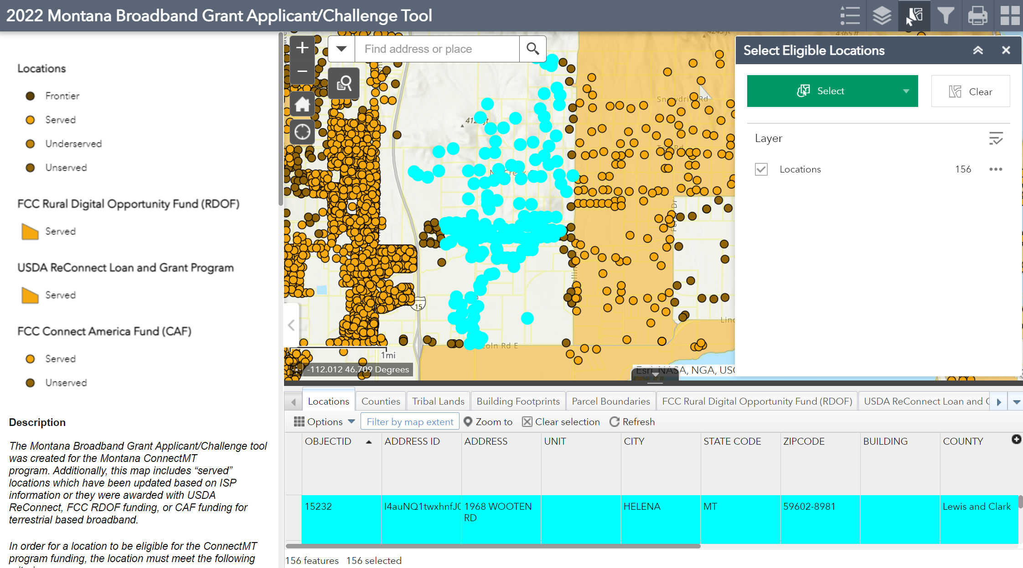
2022 Montana Broadband
Grant Applicant / Challenge Map

Slide 26
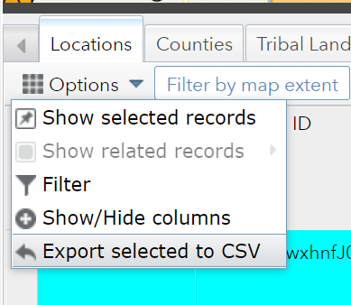
2022 Montana Broadband
Grant Applicant / Challenge Map

Slide 27
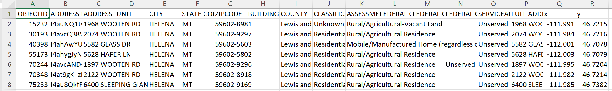
2022 Montana Broadband
Grant Applicant / Challenge Map

Slide 28
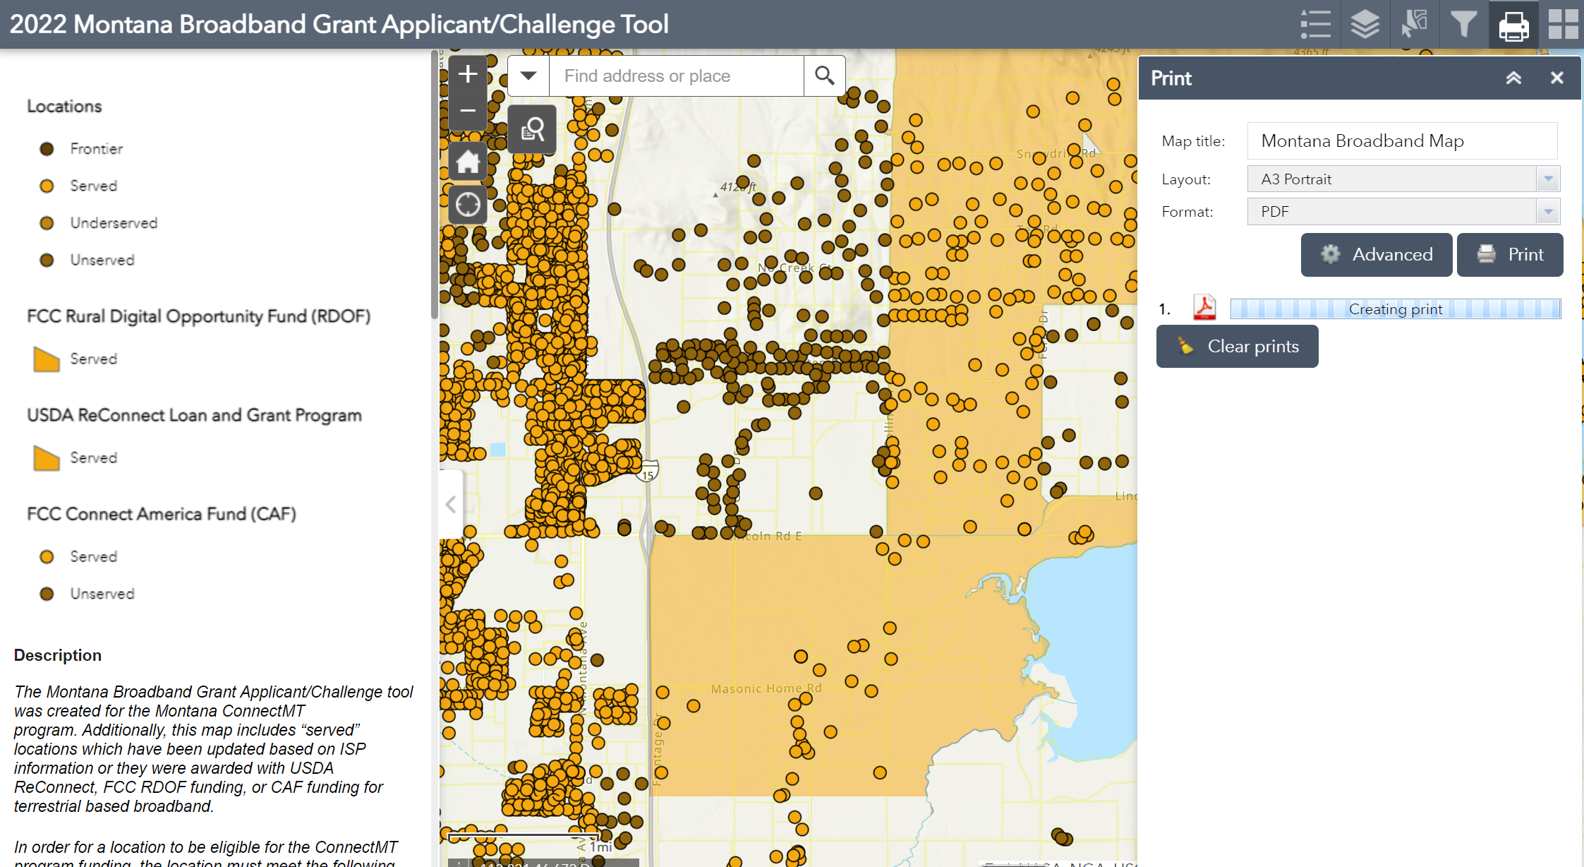
2022 Montana Broadband
Grant Applicant / Challenge Map

Slide 29
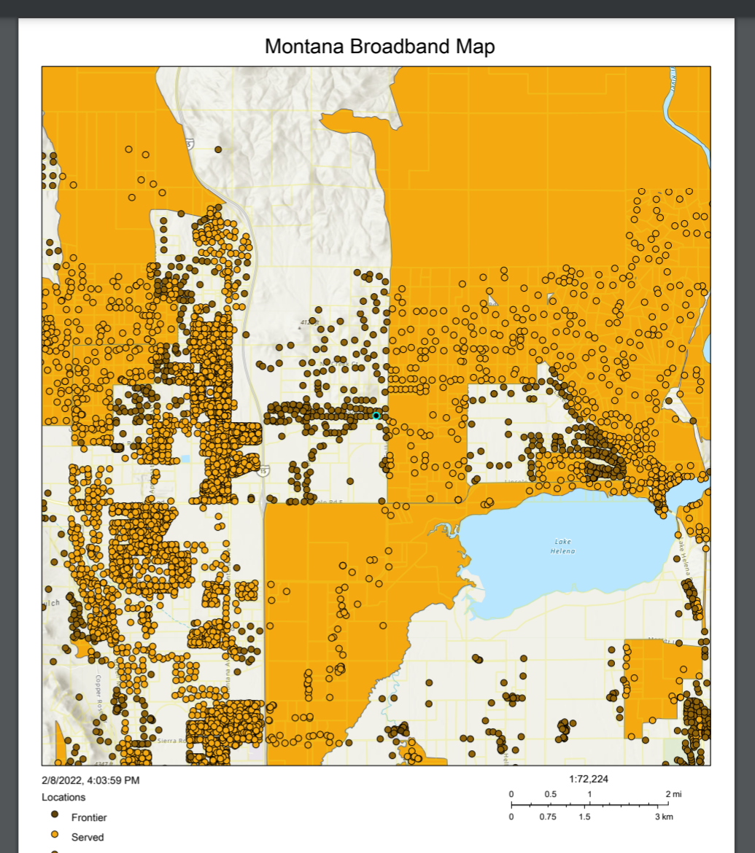
2022 Montana Broadband
Grant Applicant / Challenge Map

Slide 30
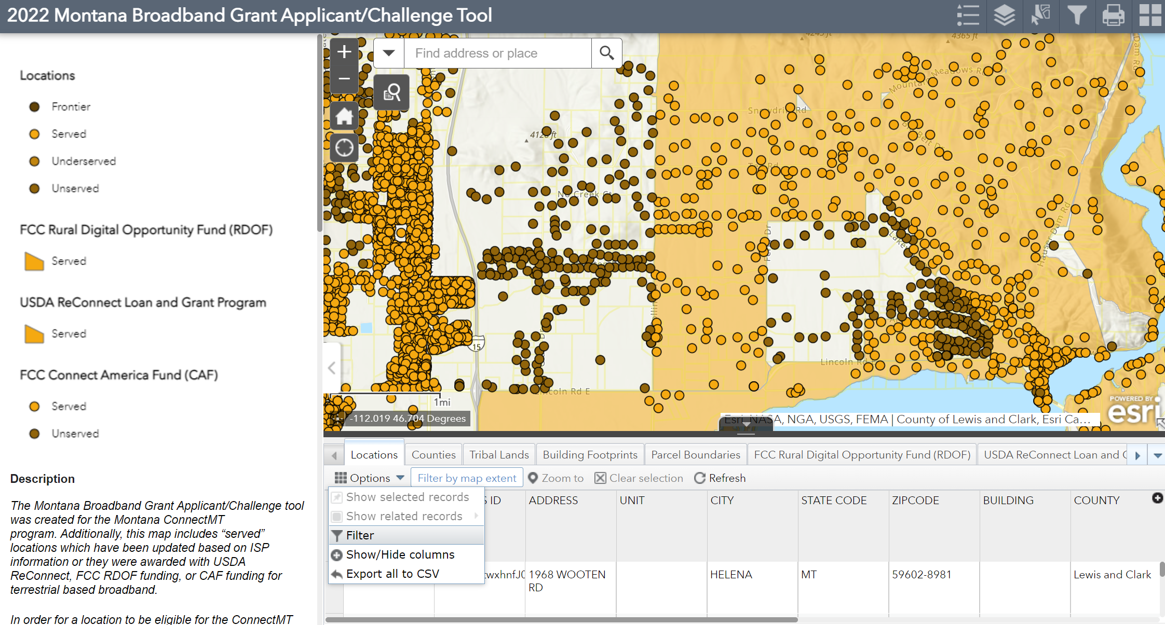
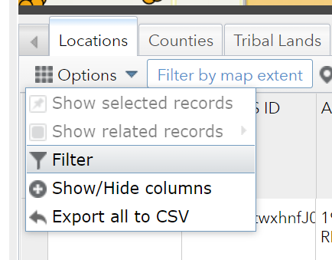
2022 Montana Broadband
Grant Applicant / Challenge Map

Slide 31
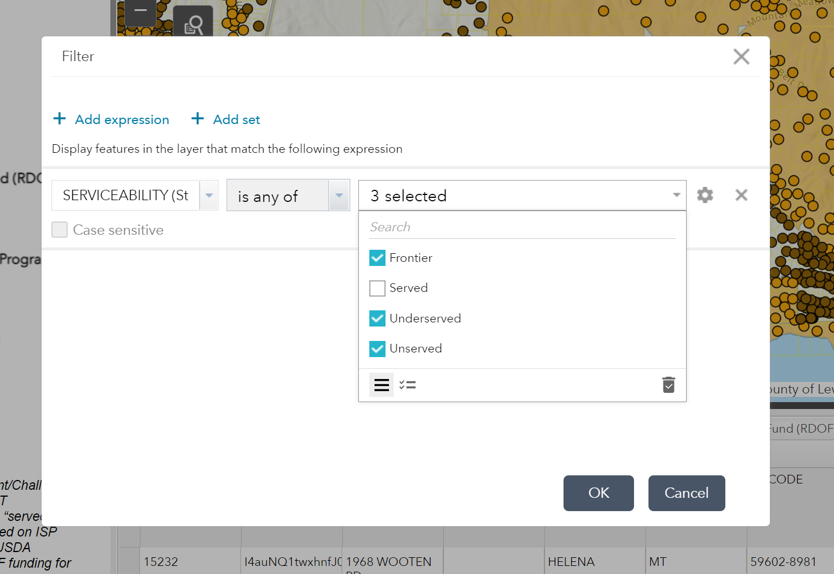
2022 Montana Broadband
Grant Applicant / Challenge Map

Slide 32
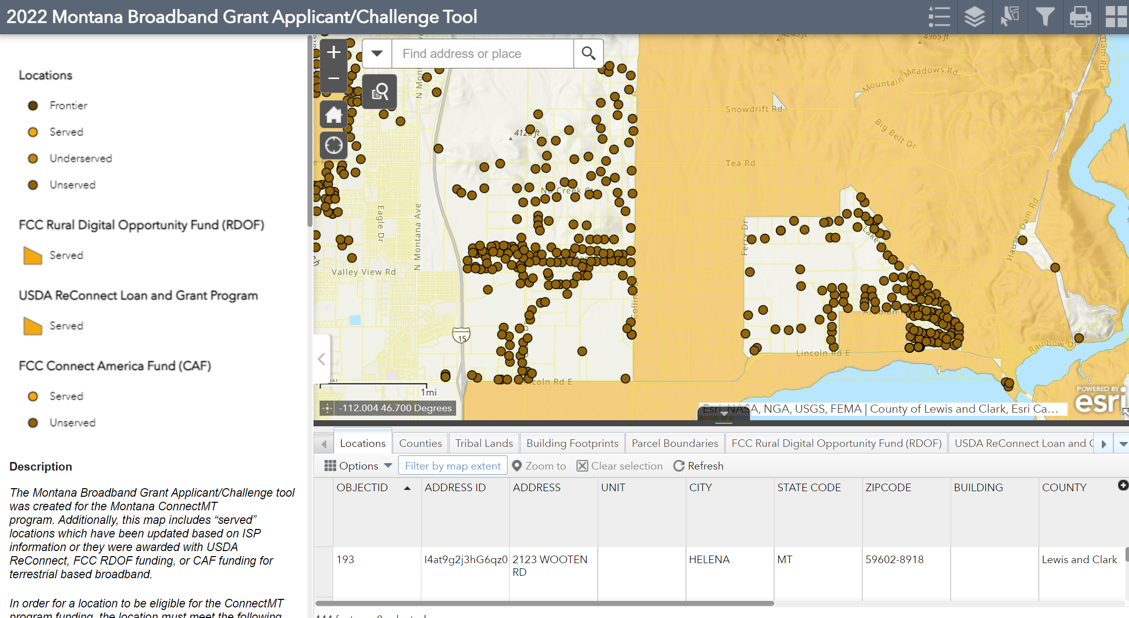
2022 Montana Broadband
Grant Applicant / Challenge Map

Slide 33
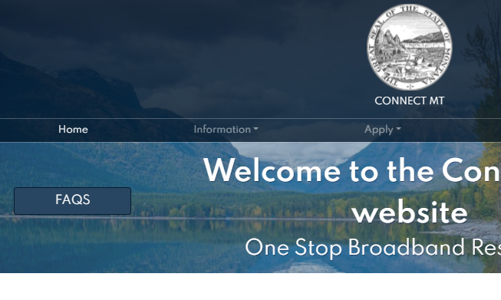
Map Additional Information
FAQ Link for Map questions
Connectmt.mt.gov - FAQ link

Slide 34
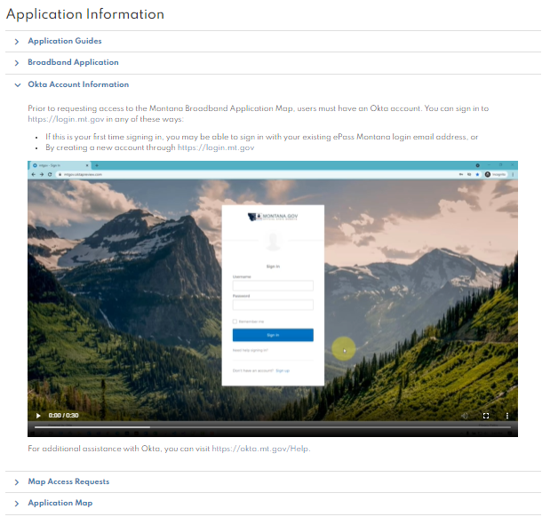
OKTA Registration for Map Access
OKTA is the single sign-on for the State of Montana
Go to Connectmt.mt.gov – click on Apply Tab – instructions and video provided to guide through registering for account on Login.mt.gov

Slide 35
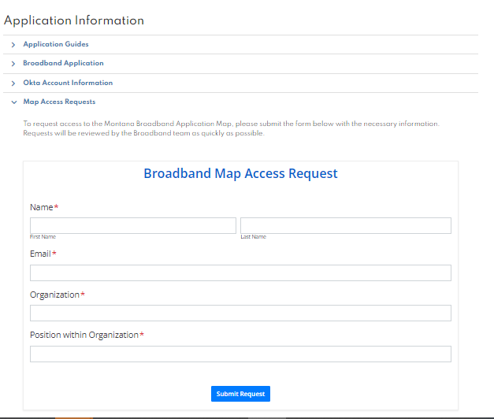
Request Map Access
From the Apply Section of conectmt.mt.gov – click on the next link “Map Access Requests”
Complete and Submit – you will receive a notification once your request has been approved.

Slide 36
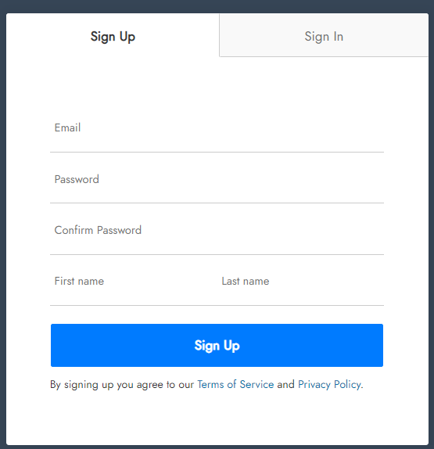
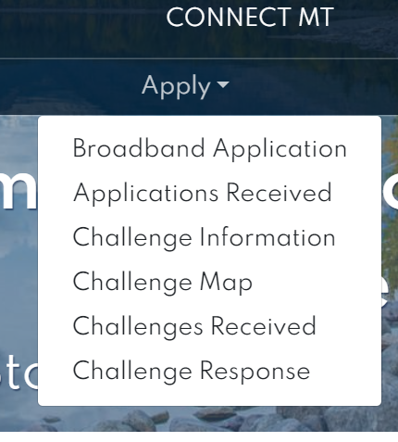
Registering with Website
https://www.covidreliefmt.org/submit
Clicking “Broadband Application” will bring applicant to Montana Grant Application Portal
Registration will be prompted and will redirect applicant to application upon completion
Application is supported by Submittable - so if you already have an account with Submittable for other grants, use the same log in

Slide 37

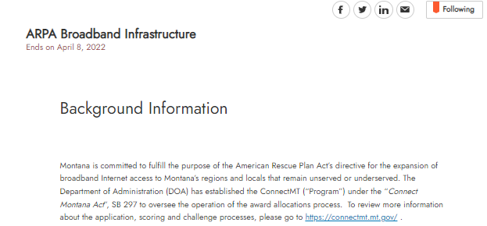
Online Application
Review Application Guidance FIRST
Gather the appropriate data and documentation
It is recommended to draft narratives outside of the Submittable online application portal.
Click SAVE after completing significant amounts of work – data may be lost and require a restart of application
When ready to submit, copy and paste work into Submittable grant application portal

Slide 38
Online Application - Continued
Applicants can only complete one application at a time
If your organization intends to submit multiple applications for different projects, your options are:
  Complete one application at a time / Submit / start new application, or
  Different individuals from the organization can initiate different applications
  Collaboration of multiple people on applications is an option within the system

Slide 39
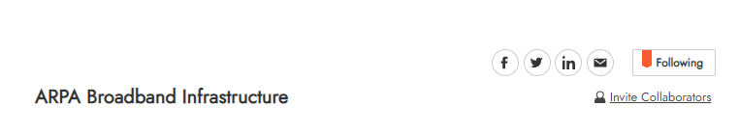
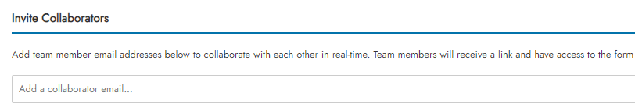
Online Application - Continued
You may Invite Collaborators to help work on the application together
Only the person that initiated the application can click “Submit” to finalize the submission

Slide 40
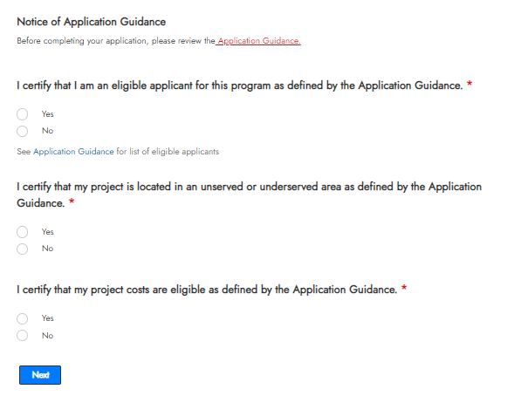
Eligibility Questions
IMPORTANT NOTE:
Review Application Guidance – see link in application – to determine if eligible to apply and if the project is eligible.
If you answer “NO” to any of these eligibility questions, a notification will pop up that you are ineligible and you will not be able to continue the application.
After verifying your eligibility, click “Next”

Slide 41
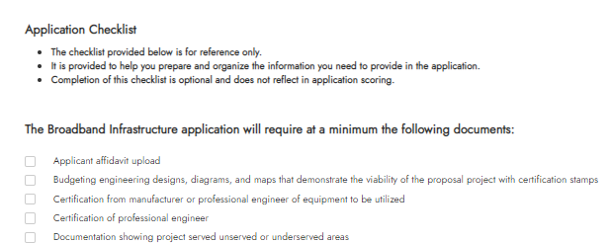
Application Checklist
Application Checklist – optional
Help you gather and organize data and documents, including budget, SAM.gov registration, SOS.mt.gov registration.

Slide 42
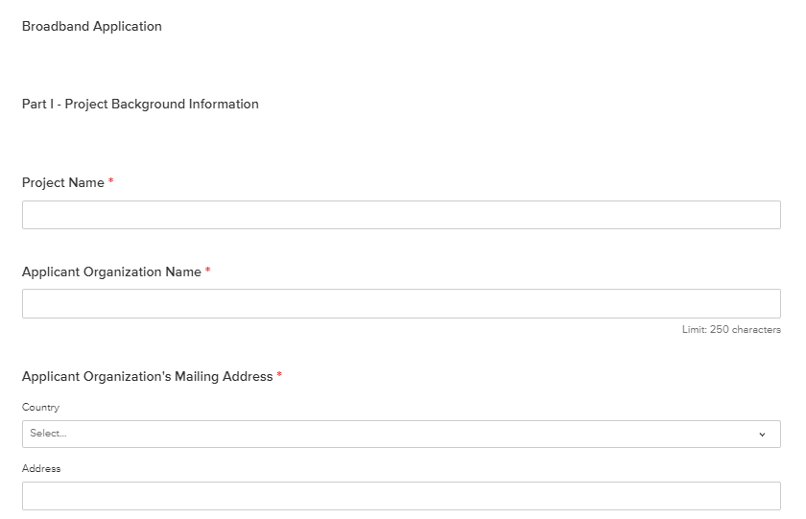
Part I
Complete contact information and project background fields

Slide 43
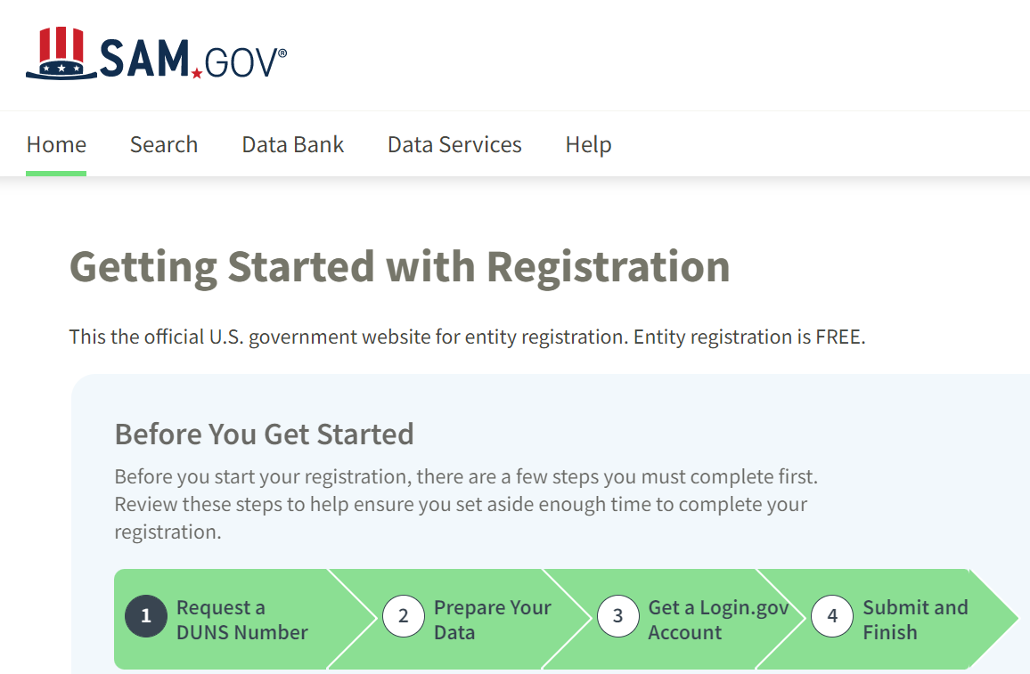
SAM.gov Registration
Provide your 13 digit SAM.gov registration number
If not registered, go to SAM.GOV to register

Slide 44
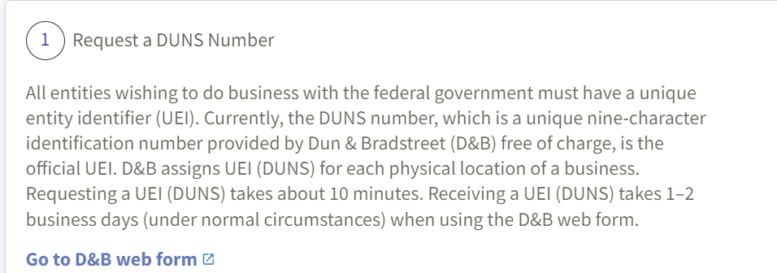
SAM.gov Registration
Request a DUNS number
Federal site indicates 1-2 days to receive DUNS number

Slide 45
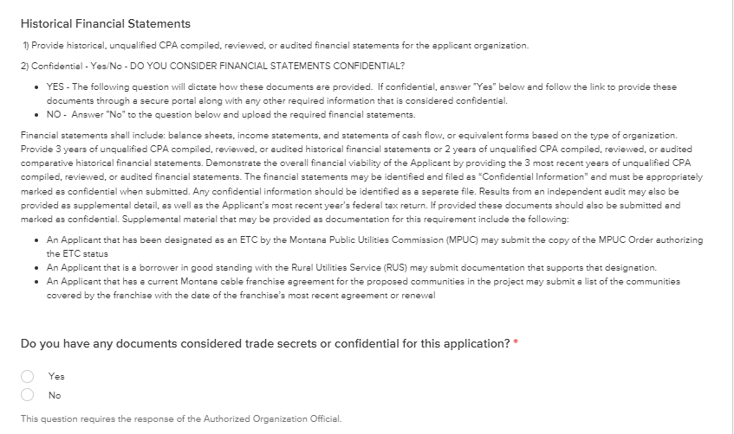
Historical Financial Statements
Decide if the historical financial statements are considered “confidential” or can be provided as public information
If you have ANY confidential or trade secret information – this is where you can indicate as such and provide that info via the provided instructions

Slide 46
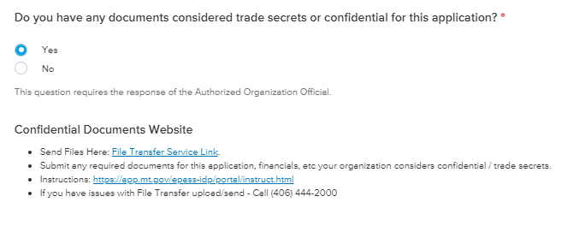
Confidential Yes?
If you have confidential / trade secret documents – use the File Transfer Service
DO NOT UPLOAD confidential / trade secret documents in the application portal

Slide 47

Confidential - No
If financial documents are not confidential, upload requested documents in this field in the Submittable application form

Slide 48

Part II – Project Location Information
Provide requested project location information.
Select any/all counties that are served by this project.

Slide 49

Map Upload
Click “Choose File”
Select files from your device
Reminder: All GIS shapefiles must be submitted in .zip files

Slide 50

Part III – Project Funding
Provide project funding information, including matching funds data

Slide 51

Part IV – Broadband Improvements
Provide Broadband Improvements information

Slide 52

Part V – Community Participation
Provide Community Support documentation
Letters of endorsement

Slide 53

Part VI – Project Readiness
Review Eligible Uses of Funds
Upload Uses of Funds Document

Slide 54

Project Implementation
If you answer “yes” to providing broadband services for minimum 5 years – additional field will pop up
Upload Documentation including estimated subscription take rates for the proposed project area.

Slide 55

Part VII – Project Sustainability
Provide requested narrative detailing technical expertise of the applicant and experience
Note the character limitation
Do not forget to click “Save Draft” frequently as you continue working through the application

Slide 56

Part VIII – Applicant Affidavit

Slide 57

Additional Attachments
Attach any additional relevant information. This is optional – available for use if needed.
Please name files descriptive relative to the information provided.

Slide 58


Application Submission
Save and Submit Feature
Found at bottom of application
Do not forget to click “Save Draft” after completing work in application
Want a printed copy or PDF of your application?
  Hit “Print” before “Submit”
  OR – Log back into your Submittable account and download a copy from there

Slide 59

Where to Find Application After Submitted
Log back into your account at covidreliefmt.org/login
Found at bottom of application
Do not forget to click “Save Draft” after completing work in application
Want a printed copy or PDF of your application?
  Hit “Print” before “Submit”
  OR – Log back into your Submittable account and download a copy from there

Slide 60

Where to Find Application After Submitted
Log back into your account at covidreliefmt.org/login
Found at bottom of application
Do not forget to click “Save Draft” after completing work in application
Want a printed copy or PDF of your application?
  Hit “Print” before “Submit”
  OR – Log back into your Submittable account and download a copy from there

Slide 61

Application Guide

Slide 62
Timeline
Date | Item
2/7/22-4/8/22 | Statewide Application window
2/10/2022 | Application Webinar
4/13/2022 | Applications available for public review
4/14/22-5/12/22 | 30-day Challenge period
5/27/2022 | DOA repsonses to challenges
5/30/22-6/3/22 | Applicants open to modify applications
June 2022 | Receive ARPA funds from US Treasury
6/4/22-6/30/22 | Review eligible applications & determine awards
6/30/2022 | Obligate and announce awards

Slide 63
Online Challenge Process
Refer to SB 297 for more information on the challenge process

Slide 64
Q&A Section

