Slide 1
CONNECT MT BROADBAND PROGRAM
ARPA & IIJA UPDATES
MACO BROADBAND FUNDING SUMMIT
April 13th, 2022

Slide 2
State of Construction Industry Russ Katherman
ARPA Broadband Funding Chad Rupe
Proposed Priorities for State Broadband Plan Misty Ann Giles/Chad Rupe
ARPA / IIJA Timelines Chad Rupe
Next Steps / Legislative Action Misty Ann Giles/Chad Rupe
MORNING AGENDA

Slide 3
State of construction industry re: raw materials

Slide 4
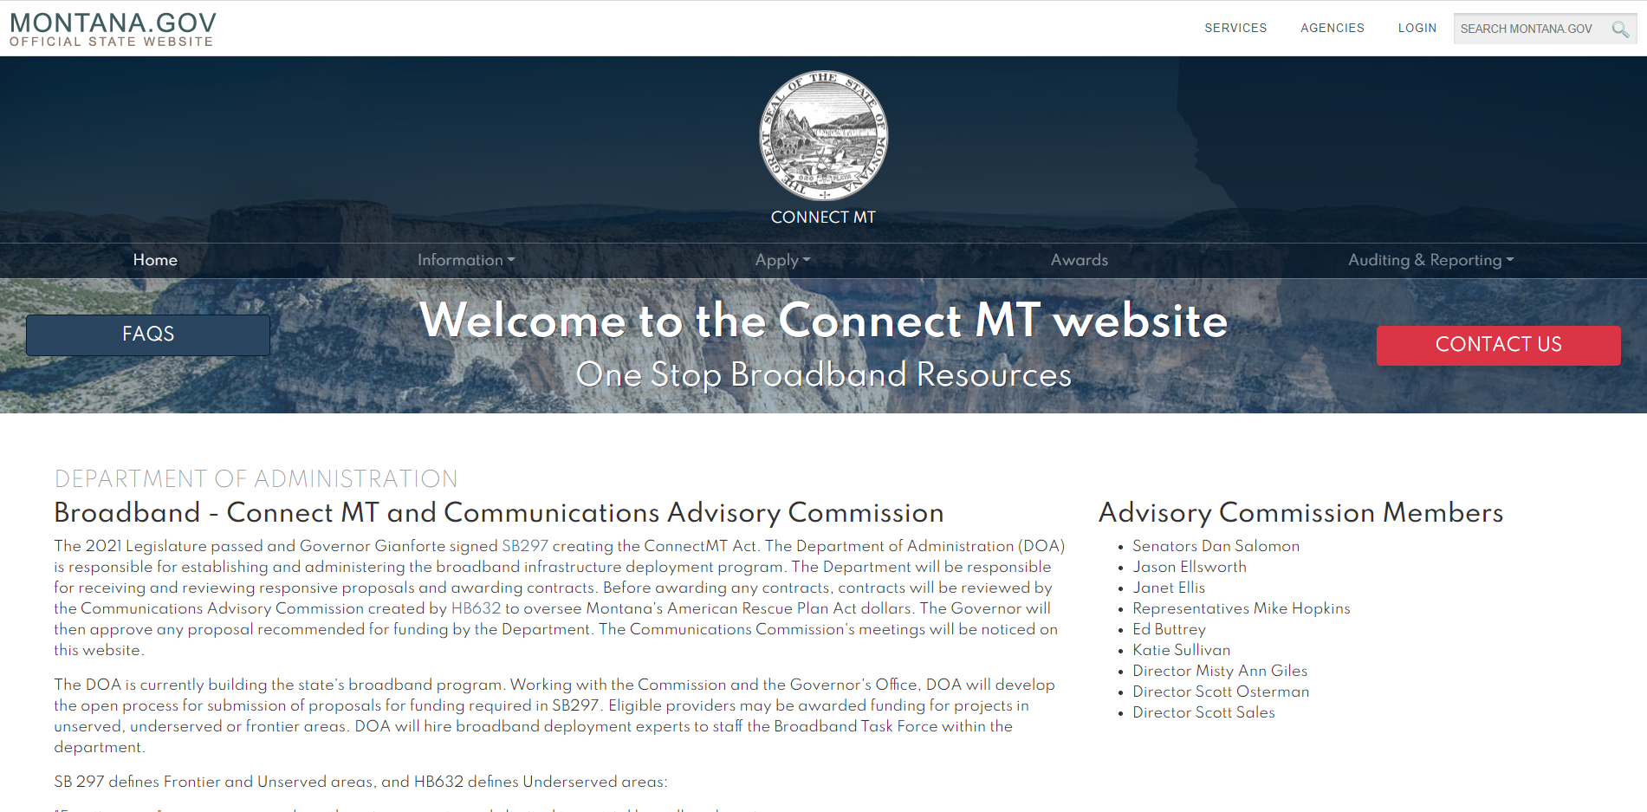
Website Orientation
https://connectmt.mt.gov/
Website includes:
FAQs
Information about the statewide broadband map, federal resources, announcements, events, webinars, forms,
and guides
Application link and guidance
Project challenge process
Awards
Auditing and reporting
Contact information

Slide 5
Connect MT Map Overview

Slide 6
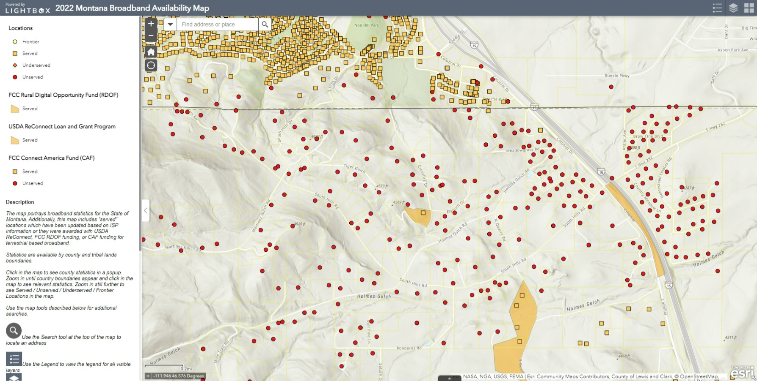
Data and Mapping: Smart Agile Project Management Approach

Slide 7
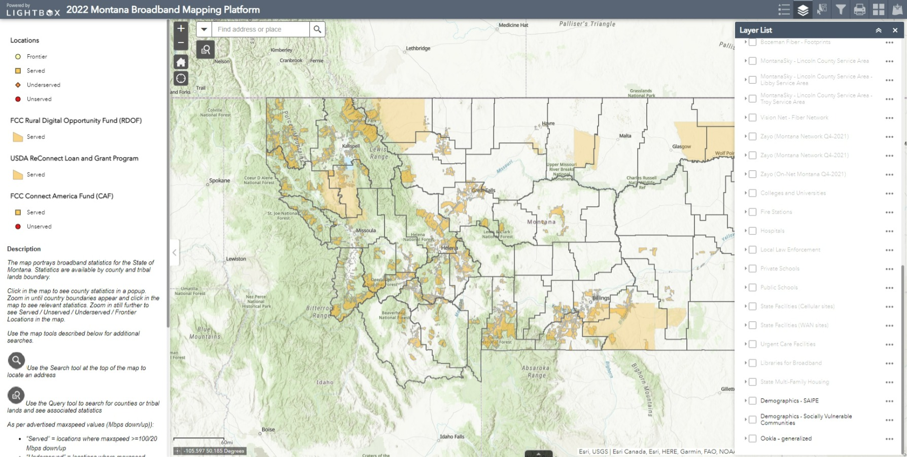
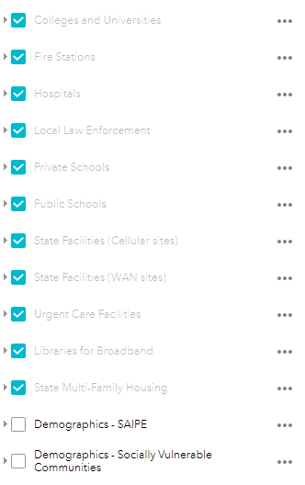
Data and Mapping: What is Behind the Firewall?

Slide 8
CONNECT MT APPLICATION
https://connectmt.mt.gov/

Slide 9
APPLICANTELIGIBILITY
Has authorization to do business in the state.
Has demonstrated that it has the technical, financial, and managerial resources and experience to provide broadband service or other communications service to customers in the state.
May only be a nongovernment entity with demonstrated experience in providing broadband service or other communications services to end-user residential or business customers in the state.
Shall commit to paying a minimum of 20% of the project costs and may not provide a minimum matching amount from any funds derived from government grants or subsidies, except for federal funds designated for broadband deployment.
May not receive funds under any other federal or state government grant or loan program where government funding supports 100% of the proposed project’s capital costs.

Slide 10
ELIGIBILITY (CONT.)
Must be enrolled as an Affordable Connectivity Program (ACP) Provider
Show evidence of Good Standing with Montana Secretary of State
Provide Federal Employer Identification Number
SAM.gov enrollment

Slide 11
ELIGIBLE REIMBURSEMENTS
Scalable to speeds of at least 100 Mbps
Exceptions explained further in Section 6.5
Funds may not be used to support noncapital expenses including:
general operations of an eligible provider
nonbroadband services
marketing or advertising
20% match required
Eligible Costs can only be incurred after the award contract is granted
No pre-application expenses

Slide 12
AREA ELIGIBILITY
Frontier: no or extremely limited access to terrestrial broadband services
Unserved: 10% with no access to broadband service at or above 25/10
Underserved: 10% with no access to broadband service at or above 100/20
RDOF areas are NOT eligible
The Proposed Project as a whole may serve non-eligible areas
Federal allocation funds can only be used for eligible areas.
Applicants will need to clearly delineate this in the application.

Slide 13
CAPACITY + SCALABILITY
Does your solution provide 100Mbps/100Mbps?
Proposed solutions that do not meet this capacity threshold will require the following:
Substantial narrative detailing the technical barriers to providing 100Mbps/100Mbps service
Cost justification for the lower capacity service (on a per location basis)
Identification of the steps required to upgrade the proposed solution to the desired 100Mbps/100Mbps service
Demonstrate Scalability to 100Mbps/100Mbps
Documentation must be provided to show the proposed solution provides 100Mbps/100Mbps on can be scaled to meet these speeds
This includes the appropriate specifications and narrative for the review team to assess
This documentation must be certified either by the equipment manufacturer or a registered Professional engineer

Slide 14
PERMITTING
Identify What Permitting is Required for the Deployment of your Project
Remember to make sure permitting timelines are accounted for in the presented project timelines
Environmental Compliance and MEPA Checklist
The checklist can be found on the forms and guides section of the website connectmt.mt.gov

Slide 15
FINANCIAL REQUIREMENTS, 1 of 2
Balance Sheets, Income and Cash Flow Statements, or equivalents
Provide 3 years of unqualified historical financial statements
OR
2 years of unqualified comparative historical financial statements
All historical financials must be CPA compiled, reviewed, or audited
Notes:
Section 6.7

Slide 16
Pro Forma Requirements
Supplemental Information
Most recent year of federal tax returns
Independent audit
Proposed Budget
See Sample Budget Table
FINANCIAL REQUIREMENTS, 2 of 2
Notes:
Section 6.7

Slide 17
INFRASTRUCTURE LEGISLATION (IIJA)
NTIA broadband grants ($42.45 billion) to states that then subgrant to providers by awarding funding first to unserved areas (80% without 25/3), then underserved areas (80% without 100/20), then anchor institutions that lack “gigabit-level broadband service”
No preference for types of providers
Providers must deploy at least 100/20 capable networks within 4 years
Each state to receive at least $100 million
States may award funds for broadband deployment, data collection, mapping, and other purposes
25% match required but ARPA and other federal resources can supply match
$1 billion for middle mile network deployment
$2.75 billion to states for furthering broadband adoption and digital literacy

Slide 18
STATE BROADBAND FUNDING

Slide 19
Access: Close the Digital Divide with both last mile and middle mile connectivity
130,100 locations without service at 100 mbps symmetrical (22% of about 588,000 broadband serviceable locations in Montana lack service)
88,300 locations unserved (less than 25/10)
32,800 locations underserved (less than 100/20)
9,000 locations frontier (less than 4/1)
Affordability: Increase eligible enrollments by 42,000 households in Affordable Connectivity Program
12.4% are in poverty in Montana (approximately 64,000 of 519,000 households in Montana)
As of February 14, 2022: 21,248 enrollments in Affordable Connectivity Program in Montana
65% are for mobile broadband, 35% are fixed broadband (national average)
As of December 31, 2021: 9.62% of eligible households enrolled in Montana (Ranked 42nd of 50 States)
Adoption: Support providers and workforce development with community-based programs
Digital Literacy Training, Cybersecurity Awareness, Workforce Development focused on veterans, low-income homes, elderly, disabled, incarcerated, minorities, rural populations
PROPOSED PRIORITIES FOR STATE BROADBAND PLAN

Slide 20
ARPA funded ConnectMT Program Application Window Closes April 29
Publish Executive Summaries and Maps of Each Application May 5
Challenge Window May 6 - 31
Department Review of Challenges May 6 - June 14
Department review of ARPA applications June 1-July 8
Communications Advisory Commission Reviews ARPA projects July 19
Governors Office Approval of ARPA Projects July 29
Update State Broadband Map to reflect ALL federal awards in MT July 30
Obligate and begin servicing $266 million in ARPA awards August
ARPA DEPLOYMENT TIMELINES

Slide 21
NTIA releases NOFO on BEAD and Middle Mile Programs May 16
NTIA releases NOFO on Digital Equity Programs June 1
State submits Letters of Intent to participate in each NTIA program June (TBD)
(BEAD & Digital Equity State Planning Grant)
Receive $5 million in planning funds from NTIA for BEAD program July
Conduct Statewide Community Engagement/Prepare State Broadband Plan Fall 2022
(BEAD and Digital Equity)
FCC Releases Updated Broadband Data Collection Map Late 2022
2023 Montana Legislative Session
IIJA PLANNING . . . UPCOMING TIMELINES

Slide 22
Submit Initial Plan to NTIA for BEAD funding/Submit Digital Equity Plan May 2023
NTIA releases 20% of state allocation for BEAD funding June 2023
Apply for Digital Equity Capacity Program June 2023
Conduct Application Window for NTIA BEAD funding Summer 2023
Conduct Application Window for Digital Equity Capacity Program Summer 2023
Submit Final Plan to NTIA for BEAD funding Fall 2023
NTIA releases 80% of state allocation for BEAD Program Fall 2023
Obligate NTIA BEAD funding Fall 2023
Receive NTIA Funding Approval/Implement Digital Equity Capacity Program Fall 2023
IIJA PLANNING . . . UPCOMING TIMELINES

Slide 23
SB 297 Modifications - Need to Align State Law with Federal Rules for Participation
Discussion of Hot Topics:
access: eligibility, terrestrial service, mobile vs. fixed, wireless vs. wireline
adoption: digital equity topics: workforce development; digital literacy
MONTANA LEGISLATION IMPACTS
ON IIJA IMPLEMENTATION

Slide 24
Contact Us:
1.844.406.ARPA(2772) or visit connect.mt.gov
Misty Ann Giles, Director, Department of Administration
406.444.2460 / mistyann.giles@mt.gov
Chad Rupe, Broadband Director, Department of Administration
406.444.5475 / chad.rupe@mt.gov
Russ Katherman, State Architect and Engineer, Department of Administration
406.444.3332 / rkatherman@mt.gov
QUESTIONS

Slide 25
NTIA TIMELINES ON ACCESS PRIORITY

Slide 26
KEY PRIORITIES . . . BETWEEN NOW AND NOFO RELEASES

Slide 27
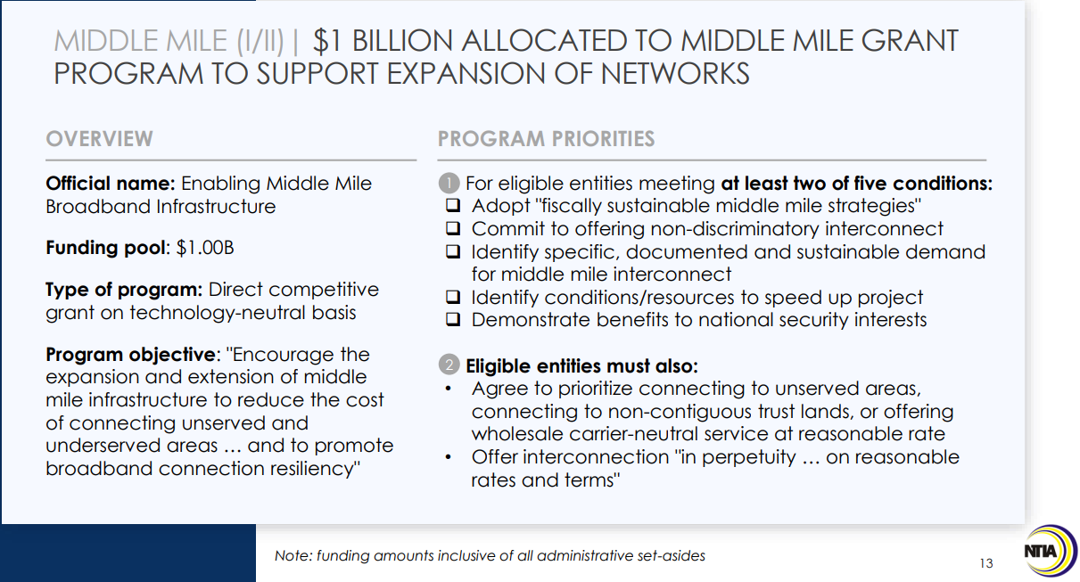
NTIA MIDDLE MILE
ACCESS

Slide 28
Provides a discount of up to $30 per month toward internet service for eligible households and up to $75 per month for households on qualifying Tribal lands.
Eligible households can also receive a one-time discount of up to $100 to purchase a laptop, desktop computer, or tablet from participating providers if they contribute more than $10 and less than $50 toward the purchase price.
ELIGIBILITY:
Household income is at or below 200% of the Federal Poverty Guidelines, or if a member of the household meets at least one of the criteria below:
Received a Federal Pell Grant during the current award year;
Meets the eligibility criteria for a participating provider's existing low-income internet program;
Participates in one of these assistance programs:
SNAP
Medicaid
Federal Public Housing Assistance
Supplemental Security Income (SSI)
WIC
Veterans Pension or Survivor Benefits
or Lifeline;
Participates in one of these assistance programs and lives on Qualifying Tribal lands:
Bureau of Indian Affairs General Assistance
Tribal TANF
Food Distribution Program on Indian Reservations
Tribal Head Start (income based)
AFFORDABLE CONNECTIVITY PROGRAM

Slide 29
ADOPTION PRIORITY

Slide 30
PLANS FOR LOCAL COORDINATION

Slide 31
FCC BROADBAND DATA COLLECTION + MAPPING
Updates and Next Steps:
Fabric Contract Award issued on Nov. 9 to CostQuest
FCC Speed Test App Contract Modifications for Mobile Challenge, Crowdsource Updates
Contracts Expanded for Technical Assistance Resources
IIJA Rule Revisions
Additional outreach to States and other filers/entities
Other Contracts (e.g. wireless RF engineering resources)
Open Submission Window
Process Data + Publish Maps/Data
Begin Challenge + Verification Process
Ways to Participate:
Challenges
Provider data: direct challenges or through assistance to consumers
Fabric: geolocate locations within your jurisdictions
Submit Primary Data
Must meet technical requirements
Submit Crowdsourced Data

